Slide 1

Data gathered for this project by:
Warby Parker
Analyze Data with SQL
Clint Prentice
10/30/2024

Slide 2
Table of Contents
Which questions have a lower completion rate? What do you think the reason is?
What are some actionable insights for Warby Parker?

Slide 3
1. Which questions of the quiz have a lower completion rate?

Slide 4
1.1 Finding Responses
Question | Number of responses
1. What are you looking for? | 500
2. What’s your fit? | 475
3. Which shapes do you like? | 380
4. Which colors do you like? | 361
5. When was your last eye exam? | 270
-- Finding number of responses for each question
SELECT
question,
COUNT(DISTINCT user_id)
FROM survey
GROUP BY question;
Question 5 has a significant drop off in responses from the other questions. This could be from:
Sensitive information
No up-to-date eye exam

Slide 5
2. Actionable Insights

Slide 6
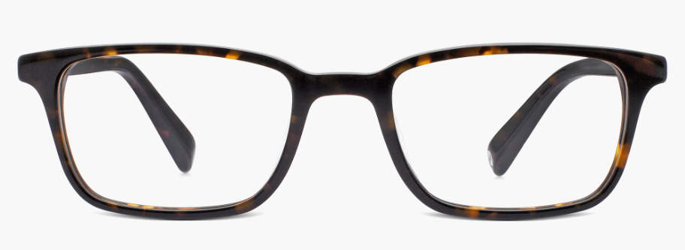
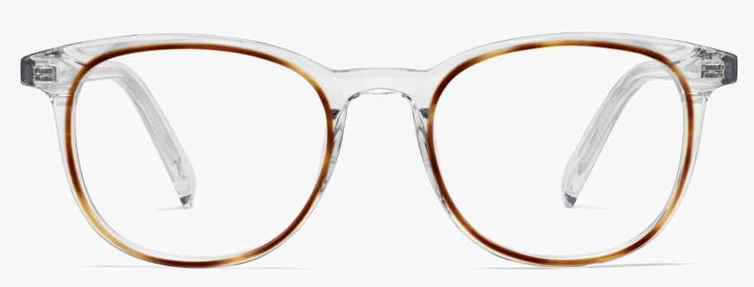
Most Popular Choices
Attribute | Response | Total Responses
Style | Women’s Styles | 469
Fit | Narrow | 408
Shape | Rectangular | 397
Color | Tortoise | 292
2.1 Style Quiz Trends
Depending on when this data was pulled, we can correlate color with seasonality of glasses
Most respondents preferred rectangular shapes.
Least popular combination of glasses would be a Wide, Round, Two-Toned pair
Least Popular Choices
Attribute | Response | Total Responses
Style | Men’s Styles | 432
Fit | Wide | 198
Shape | Round | 180
Color | Two-tone | 104
vs

Slide 7
2.2 Home Try-On: Three vs Five
WITH home_try_on_data AS (
SELECT
user_id,
number_of_pairs
FROM home_try_on
WHERE number_of_pairs IN ('3 pairs', '5 pairs')
),
purchase_data AS (
SELECT
h.user_id,
h.number_of_pairs,
CASE
WHEN p.user_id IS NOT NULL THEN 1
ELSE 0
END AS made_purchase
FROM home_try_on_data h
LEFT JOIN purchase p
ON h.user_id = p.user_id)
)
SELECT
number_of_pairs,
COUNT(*) AS total_users,
SUM(made_purchase) AS total_purchases,
ROUND(SUM(made_purchase) * 1.0 / COUNT(*) * 100, 2) AS purchase_rate
FROM purchase_data
GROUP BY number_of_pairs;
Number of pairs | Total Users | Total Purchases | Purchase Rate
3 Pairs | 379 | 201 | 53.03%
5 Pairs | 371 | 294 | 79.05%
Users ordering 5 pairs are 49.53% more likely to purchase glasses!

